Slide 1
CHAPTER ONE
Transaction Management and Concurrency Control
Worku Muluye

Slide 2
Learning Objectives
After completing this chapter, should be familiar with the following concepts.
Transaction
ACID properties of DBMS
Concurrency Control
Problems of Concurrent Sharing
Concurrency Control techniques
Serializability
Backup and Recovery

Slide 3
1. Transaction Management and Concurrency Control
Transaction: is a set of logical operations.
Transaction Management plays a critical role to ensure efficiency and consistency.
Concurrency Control deals with interleaved execution of more than one transaction.
1.1. Single-User versus Multiuser Systems
Number of users who can use the system can be: single or multiuser.
Single-user: at most one user at a time can use the system.
Multiuser: many users can use the system & access the database concurrently.
E.g. airlines, banks, insurances, stocks, supermarkets, schools are multiuser systems.
Problem
How to make the simultaneous interactions of multiple users with the database safe, consistent, correct, and efficient?

Slide 4
1.2. Transaction
A transaction is a collection of operations that performs a single logical function.
Transaction is logical unit of work on the database.
Changes made in real time to a database are called transactions.
A transaction can have one of two outcomes: committed and aborted.
E.g. ATM transactions, credit card approvals, flight reservations, hotel check-in, phone calls, supermarket canning, academic registration and billing.

Slide 5
1.2.1. Transaction Subsystem
Transaction Manager: coordinates transactions on behalf of application programs.
Communicates with scheduler (lock manager) which is responsible for implementing a strategy for concurrency control.
Scheduler: ensures that the individual steps of different transactions preserve consistency.
Recovery Manager: Ensures that database is restored to the original during failure.
Buffer Manager: responsible for transfer of data between disk storage and main memory.

Slide 6
1.3. Transaction Management
Transaction is the execution of user program in DBMS.
Transaction is different from the execution of the program external to DBMS.
Transaction management is responsible for the efficiency & consistency of the database.
To maintain the accuracy and the consistency of the database several scheduling algorithms are used.
Transaction Manager schedule the transactions and provide the safest path to complete the task.

Slide 7
1.3.1. Key Notations in Transaction Management
The key notations of transaction management are:
Object: The smallest data item which is read or write by the transaction is called as Object.
Transaction: Transaction is represented by the symbol T. It is execution of query in DBMS.
Read Operation: it is notated by symbol R(object-name).
Write Operation: it is notated by symbol W(object-name).
Commit: This term used to denote the successful completion of one transaction.
Abort: This term used to denote the unsuccessful or interrupted Transaction.

Slide 8
1.3.2. Transaction Processing System(TPS)
A system that manages transactions and controls their access to a DBMS.
Transactions can be started, attempted, then committed or aborted via DML of SQL.
Any transaction can have one of two outcomes: Success and Failure.
Success: transaction commits and database reaches a new consistent state
Committed transaction cannot be aborted or rolled back.
How do you discard a committed transaction?
Failure: transaction aborts and database must be restored to consistent state before it started.
Such a transaction is rolled back (can be restarted later) or undone.

Slide 9
1.3.3. State of a Transaction(1)
The recovery manager of the DBMS needs to keep track of the following operations:
Begin Transaction: This marks the beginning of transaction execution.
Read or Write: two possible operations on the data
End Transaction: This specifies that read and write transaction operations have ended.
A transaction can end in the following states:
COMMIT: successful end of the transaction; changes can be “committed” to DB
ROLLBACK (ABORT): the unsuccessful end of the transaction, changes applied to DB must be undone

Slide 10
1.3.3. State of a Transaction(2)
Start Commit
Ok to Commit
Commit
Database Modified
No Error
System Detects Error
Modify
Abort
End of Transaction
Error Detected by Transaction
System Initiated
Consistent State
Consistent State
Error
Transaction Initiated
Rollback
Database unmodified

Slide 11
1.3.4. ACID Property
A transaction has some basic features or properties to be considered as a valid transaction.
These features are: A: Atomicity, C: Consistency, I: Isolation, D: Durability
These are referred as ACID property of transaction.
Without the ACID property, the integrity of the database cannot be guaranteed.
ACID properties, in totality, provide a mechanism to ensure correctness and consistency of a database.

Slide 12
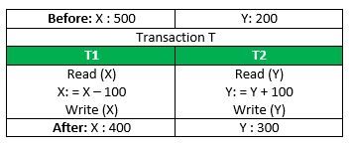
1. Atomicity
The all-or-nothing property (‘All or nothing rule’). Transactions do not occur partially.
Transaction is an indivisible unit. Every transaction cannot be subdivided into small tasks.
Abort: If a transaction aborts, changes made to the database are not visible.
Commit: If a transaction commits, changes made are visible.
Consider the following transaction T1 and T2: Transfer of 100 from account X to account Y.

Slide 13
2. Consistency
The DBMS can ensure consistency by enforcing integrity and enterprise constraints.
Consistency refers to the correctness of a database.
Transaction must transform the database from one consistent state to another consistent state.
It is the responsibility of both the DBMS and the application developers to ensure consistency.

Slide 14
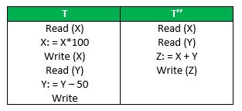
3. Isolation
Transactions execute independently of one another.
A transaction must execute without interference from other concurrent transactions.
Data must not be visible to other transactions until that particular change in that transaction is written to memory or has been committed.
It is the responsibility of the concurrency control subsystem to ensure isolation.
Let X=500, Y=500. Consider two transactions T and T”.
T: (X+Y = 50,000 + 450 = 50,450)
T”: (X+Y = 50,000+500=50,500)

Slide 15
4. Durability
This property ensures the effects of a successfully completed (committed) transaction are permanently recorded in the database.
Atomicity and Durability are closely related.
Consistency and Isolation are closely related.
To enforce Consistency and Isolation concept DBMS is Serial Scheduling.

Slide 16
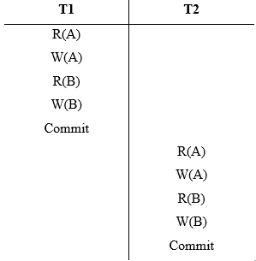
1.4. Types of Transaction Schedules
1. Serial Scheduling: transactions are executed one by one from the start to finish.
Figure 1‑1: Serial scheduling

Slide 17
2. Complete Schedules: the last operation of each transaction is either aborted or committed are called complete schedules.
3. Recoverable Schedules: Schedules in which transactions commit only after all transactions whose changes they read commit are called recoverable schedules.
In other words, if some transaction Tj is reading value updated or written by some other transaction Ti, then the commit of Tj must occur after the commit of Ti.
T₁ | T₂ | T₃
R(A)
 | W(A)
R(B)
 |  | W(B)
Commit
 | Commit
 |  | Abort

Slide 18
This is a recoverable schedule since T1 commits before T2, which makes the value read by T2 correct.
T2 read the value of A written by T1, and committed. T1 later aborted, therefore the value read by T2 is wrong, but since T2 committed, this schedule is unrecoverable.
T₁ | T₂
R(A) W(A)
 | W(A) R(A)
Commit
 | Commit
T₁ | T₂
R(A) W(A)
 | W(A) R(A) Commit
Abort

Slide 19
4. Cascadeless Schedules: if transaction Tj wants to read value updated or written by some other transaction Ti, then the commit of Tj must read it after the commit of Ti.
T1 | T₂
R(A) W(A)
 | W(A)
Commit
 | R(A) Commit
This schedule is cascadeless.
Since the updated value of A is read by T2 only after the updating transaction i.e. T1 commits.
T₁ | T₂
R(A)
W(A)
 | R(A)
 | W(A)
Abort
 | Abort
It is a recoverable schedule but it does not avoid cascading aborts.

Slide 20
5. Strict Schedules: if for any two transactions Ti and Tj the Tj can read or write updated or written value of Ti only after Ti commits/aborts.
T₁ | T₂
R(A)
 | R(A)
W(A)
Commit
 | W(A)
 | R(A)
 | Commit
This is a strict schedule since T2 reads and writes A which is written by T1 only after the commit of T1.
Note: It can be seen that:
Cascadeless schedules are stricter than recoverable schedules.
Strict schedules are stricter than cascadeless schedules.
Serial schedules satisfy the constraints of all recoverable, cascadeless & strict schedules.

Slide 21
1.4.1. Ways of Transaction Execution
Basically there are two ways of executing a set of transactions:
1. Serially (Serial Execution): transactions are executed strictly serially.
Only one transaction that is being executed in the system.
The data is not shared between transactions at one specific time.
Good things about serial execution:
Correct execution, if the input is correct then output will be correct.
Fast execution, since all the resources are available to the active.
The worst thing about serial execution is very inefficient resource utilization.

Slide 22
Serial Execution: Example, suppose data items X = 10, Y = 6, and N =1 and T1 and T2 are transactions.
Time | T1 | T2
 | read (X) {X = 10}
 | X := X+N {X = 11}
 | write (X) {X = 11}
 | read (Y) {Y = 6}
 | Y := Y+N {Y = 7}
 | write (Y) {Y = 7}
 |  | read (X) {X = 11}
 |  | X := X+N {X = 12}
 |  | write (X)
Serial Execution: Final values of X, Y at the end of T1 and T2: X = 12 and Y = 7.

Slide 23
2. Concurrently: is the reverse of serially executable transactions, reads and writes are interleaved in some order.
Time | T1 | T2
 | read (X) {X = 10}
 |  | read (X) {X = 10}
 | X := X+N {X = 11}
 |  | X := X+N {X = 11}
 | write (X) {X = 11}
 |  | write (X)
 | read (Y) {Y = 6}
 | Y := Y+N {Y = 7}
 | write (Y) {Y = 7}
Final values at the end of T1 and T2: X = 11, and Y = 7.
This improves resource utilization, unfortunately gives incorrect result.
The correct value of X is 12 but in concurrent execution X =11, which is incorrect.
The reason for this error is incorrect sharing of X by T1 and T2.

Slide 24
1.3.3. Anomalies Due to Interleaved Transactions
If all the transactions are doing read operation on the database no problem.
When the read and write operations done alternatively there is a possibility of anomalies.
Three categories anomalies:
Write-Read Conflicts (WR Conflicts)
Read-Write Conflicts (RW Conflicts)
Write-Write Conflicts (WW Conflicts)

Slide 25
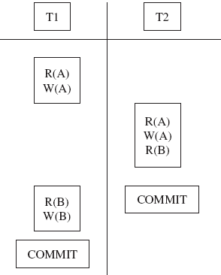
1. Write-Read Conflicts (WR Conflicts)
Dirty Read: This happens when Transaction T2 is trying to read the object A that has been modified by another Transaction T1, which has not yet been committed.
T1 transfers Birr 200 from A to B, and T2 increments both A and B by 6%.
Figure: Reading uncommitted data.

Slide 26
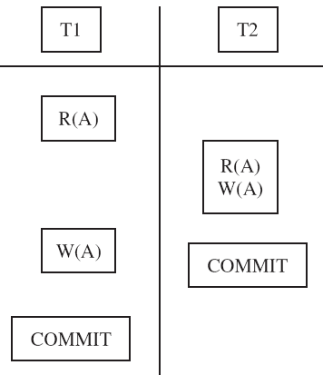
2. Read-Write Conflicts (RW Conflicts)
Unrepeatable Read: Transaction T2 could change the value of an object A that has been read by a Transaction T1, while T2 is still in progress.
If T1 tries to read A again it will get different results.
This makes the Database inconsistent.

Slide 27
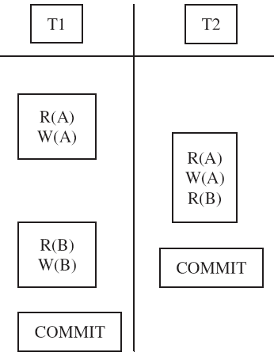
3. Write-Write Conflicts (WW Conflicts)
One Transaction is updating an object while another one is also in progress.
E.g. Consider the two Transactions T1, and T2. Consider the two objects A, and B.
Figure: WW conflicts

Slide 28
1.5. Concurrency Control(CC)
CC is the process of managing simultaneous(concurrent) operations on the database.
It prevents the loss of data integrity and its objective is to schedule transactions.
Concurrency control manager controls concurrent transactions, to ensure the consistency of the database.
To achieve concurrent transactions, the technique of interleaved execution is used.
But in this technique there is a possibility for the occurrence of certain anomalies.
There are three reasons for allowing concurrency:
Improved throughput
Improve resource utilization
Reduced waiting time

Slide 29
1.5.1. Concurrency Control Techniques
The basic concurrency control techniques are:
Locking techniques
Timestamp ordering techniques
Optimistic concurrency control techniques
Multi-version concurrency control techniques

Slide 30
1. Locking Technique
A Lock is a mechanism for enforcing limits on access to a resource in an environment.
Transaction uses locks to deny access to other transactions & prevent incorrect updates.
Lock (X): T1 applies Lock on data item X, X is not available to any other transaction.
Unlock (X): T1 Unlocks X. X is available to other transactions.
Types of Lock
Shared lock: data item can be read by several transactions simultaneously.
Share lock (X), then Read (X) and finally Unlock (X).
Exclusive lock: A data item can be modified only under Exclusive lock.
Exclusive lock (X), then Write (X) and finally Unlock (X).
When these locks are applied, then a transaction must be well-formed.
A transaction is well- formed if it does not lock a locked data item and it does not try to unlock an unlocked data item.

Slide 31
Locking Basic Rules
If a transaction has a shared lock on an item, can read but not update the item.
If a transaction has an exclusive lock on an item, can both read and update the item.
More than one transaction can hold read shared locks simultaneously on the same item.
Exclusive lock gives transaction exclusive access to that item.
T must issue read_lock(X) or write_lock(X) before any read_item(X) operation is performed in T
T must issue write_lock(X) before any write_item(X) operation is performed in T
T must issue unlock(X) after all read_item(X) and write_item(X) operations are completed in T
T will not issue a read_lock(X) if it already holds a read lock or writes lock on X .
T will not issue a write_lock(X) if it already holds a read lock or writes lock on X.
T will not issue unlock (X) requests unless it holds a read lock write lock on X.
Some systems allow transactions to upgrade a shared lock to an exclusive lock.
Suppose a lock on a data item is applied, the data item is processed and it is unlocked immediately after reading/writing is completed as follows. Initial values of A = 10 and B = 20

Slide 32
Serial Execution of T1 and then T2
T1 | T2
Lock (A)
read (A) {A = 10}
A := A + 100
write (A) (A = 110}
Unlock (A)
Lock (B)
read (B) {B = 20}
B := B + 10
write (B) {B =30}
Unlock (B)
 | Lock (B)
 | read (B) {B = 30}
 | B := B * 5
 | write (B) {B = 150}
 | Unlock (B)
 | Lock (A)
 | Read (A) {A = 110}
 | A := A + 20
 | Write (A) {A = 130}
 | Unlock (A)
Final Result: A=130 B=150
Concurrent Execution of T1 and T2
T1 | T2
Lock (A)
read (A) {A = 10}
A := A + 100
write (A) (A = 110}
Unlock (A)
 | Lock (B)
 | read (B) {B = 20}
 | B := B * 5
 | write (B) {B = 100}
 | Unlock (B)
Lock (B)
read (B) {B = 100}
B := B + 10
write (B) {B = 110}
Unlock (B)
 | Lock (A)
 | Read (A) {A = 110}
 | A := A + 20
 | Write (A) {A = 130}
 | Unlock (A)
Final Result: A=130 B=110

Slide 33
The result of the two transactions using the serial and concurrent execution is not the same.
This indicates that the above method of locking and unlocking is not correct.
To preserve consistency we have to use another approach two-phase locking scheme.
3. Two-Phase Locking (2PL)
A transaction follows 2PL protocol if all locking operations precede the first unlock operation in the transaction.
The 2PL protocol demands locking and unlocking of a transaction to have two phases.
Growing phase: acquires all locks but cannot release any locks.
Shrinking phase: releases locks but cannot acquire any new locks.

Slide 34
Strict Two phase Lock(example)
T1’
read_lock(Y)
read_item(Y) write_lock(X)
read_item(X)
X:=X+Y
write_item(X)
commit
unlock(Y)
unlock(X)
T2’
read_lock(X)
read_item(X) write_lock(Y)
read_item(Y)
Y:=X+Y
write_item(Y)
commit
unlock(X)
unlock(Y)
These transactions obey the Strict 2PL protocol

Slide 35
Locking Methods Problems: Deadlock
A deadlock occurs when two or more transactions are in a simultaneous wait state, each one waiting for one of the others to release a lock.
Example: T0, T1, T2, ..., Tn. T0 needs a resource X to complete its task. Resource X is held by T1 & T1 is waiting for resource Y, which is held by T2. T2 is waiting for resource Z, which is held by T0.
All processes wait for each other to release resources & none of the processes can finish their task. This situation is called 'deadlock’.
To keep the system deadlock-free transactions involved in deadlock are rolled back and restarted.

Slide 36
Deadlock Possible Solutions
Only one way to break the deadlock abort one or more of the transactions in the deadlock.
Two general techniques for handling deadlock:
Deadlock Prevention: If it finds that a deadlock situation might occur, then that transaction is never allowed to be executed.
Wait-Die Scheme: if a transaction requests to lock a resource that is already held with conflicting lock by some other transaction. Each transaction is assigned a timestamp (TS).
If a transaction T1 starts before transaction T2, then TS(T1) < TS(T2); T1 is older than T2.
If TS(Ti) < TS(Tj), that is Ti, which is requesting a conflicting lock, is older than Tj, Ti is allowed to wait until the data item is available.
If TS(Ti) > TS(Tj), that is Ti is younger than Tj, Ti dies.
Ti is restarted later with random delay but with the same timestamp.
This scheme allows the older transaction to wait but kills the younger one.

Slide 37
Wound-Wait Scheme: if a transaction requests to lock a data item, which is already held with conflicting lock by some other transaction, one of the two possibilities may occur:
If TS(Ti) < TS(Tj), that is Ti, which is requesting a conflicting lock, is older than Tj, Ti forces Tj to be rolled back, that is Ti wounds Tj.
Tj is restarted later with random delay but with the same timestamp.
If TS(Ti) > TS(Tj), that is Ti is younger than Tj, Ti is forced to wait until the resource is available.
In both cases, the transaction, which enters late in the system, is aborted.
B. Deadlock Detection and Recovery:
This mechanism can be used to detect any deadlock situation in advance and recover.
Timeout: The deadlock detection could be done using the technique of TIMEOUT.
Every transaction will be given time to wait in case of deadlock.

Slide 38
2. Timestamp Ordering Techniques
It is a concurrency control protocol that orders transactions with smaller time stamps, get priority in the event of conflict.
Transactions ordered globally based on their timestamp so that older transactions, transactions with earlier timestamps, get priority in the event of conflict.
Conflict is resolved by rolling back and restarting transaction.
Since there is no need to use lock there will be no deadlock.

Slide 39
Rules for permitting execution of operations in Time-stamping Method.
Suppose that Transaction Ti issues Read(A):
If TS(Ti) < WTS(A): this implies that Ti needs to read a value of A which was already overwritten. Hence the read operation must be rejected and Ti is rolled back.
If TS(Ti) >= WTS(A): then the read is executed and RTS(A) is set to the maximum of RTS(A) and TS(Ti).
Suppose that Transaction Ti issues Write(A):
If TS(Ti) < RTS(A): the Write operation must be rejected and Ti is rolled back.
If TS(Ti) < WTS(A): then this implies that Ti is attempting to Write an object value of A. hence, this write operation can be ignored.
Otherwise the Write operation is executed and WTS(A) is set to the maximum of WTS(A) or TS(Ti).
A transaction that is rolled back due to conflict will be restarted and be given a new timestamp.

Slide 40
Problem with timestamp-ordering protocol:
Suppose Ti aborts, but Tj has read a data item written by Ti
Then Tj must abort; if Tj had been allowed to commit earlier, the schedule is not recoverable.
Further, any transaction that has read a data item written by Tj must also abort
This can lead to cascading rollback.
Cascading Rollback: It occurs in database systems when a transaction (T1) causes a failure and a rollback must be performed.
Other transactions dependent on T1's actions must also be rollbacked due to T1's failure, thus causing a cascading effect.
That is, one transaction's failure causes many to fail.

Slide 41
3. Optimistic Technique
If there is a conflict, the transaction is rolled back and restarted.
There are three phases of Optimistic Techniques: Read, Validation, and Write Phases.
Read Phase
Extends from start until immediately before commit.
Transaction reads values from the database and stores them in local variables.
Updates are applied to a local copy of the data.
Validation Phase: Follows the read phase.
For read-only transactions, checks that data read are still current values.
If no interference, the transaction is committed, else aborted, and restarted.
Write Phase
Follows successful validation phase for update transactions.
Updates made to the local copy are applied to the database.

Slide 42
3. Optimistic Technique(2)
Condition 1: Tj completes its write phase before Ti starts its read phase
Tj
Read
Validation
Write
Ti
Read
Validation
Condition 2: Ti starts its write phase after Tj completes its write phase, and the read set of Ti has no items in common with the write set of Tj
Tj
Read
Validation
Write
Ti does not read anything that Tj writes
Ti
Read
Validation
Write
Condition 3: both the read set and write a set of Ti have no items in common with the write set of Tj, and Tj completes its read phase before Ti completes its read phase
Tj
Read
Validation
Ti does not read or write anything that Tj writes
Ti
Read
Validation
Validation

Slide 43
1.5.2. Granularity of Data Items
Granularity is the size of the data items chosen as the unit of protection by a concurrency control protocol. It could be:
The entire database
A file
A record
field value of a record
A page (a section of a physical disk in which relations are stored)

Slide 44
1.5.3. Problems of Concurrent Sharing(1)
The three potential problems caused by concurrency are:
A. Lost Update Problem: Successfully completed update on a data set by one transaction is overridden by another transaction/user.
Example, account with balance A=100.
T1 reads the account A
T1 withdraws 10 from A
T1 makes the update in the Database
T2 reads the account A
T2 adds 100 on A
T2 makes the update in the Database
Serially
T1 | T2
R(A)
A: A-10
W(A)
Commit
 | R(A)
 | A:A+100
 | W(A)
 | Commit
Concurrent
T1 | T2
R(A) | R(A)
A: A-10 | A:A+100
W(A) | W(A)
Commit | Commit

Slide 45
1.5.3. Problems of Concurrent Sharing(2)
In the above case, if done one after the other (serially) then we have no problem.
If the execution is T1 followed by T2 then A=190
If the execution is T2 followed by T1 then A=190
But if they start at the same time or concurrently in the following sequence:
T1 reads the account A=100
T1 withdraws 10 making the balance A=90
T2 reads the account A=100
T2 adds 100 making A=200
T1 makes the update in the Database A=90
T2 makes the update in the Database A=200
After the successful completion the final value of A will be 200 which override the update made by the first transaction that changed the value from 100 to 90.

Slide 46
1.5.3. Problems of Concurrent Sharing(3)
B. Uncommitted Dependency Problem: Occurs when one transaction can see intermediate results of another transaction before it is committed.
E.g. T2 increases 100 making it 200 but then aborts the transaction before it is committed. T1 gets 200, subtracts 10 and make it 190. But the actual balance should be 90.
C. Inconsistent Analysis Problem: Occurs when first transaction reads several values but second transaction updates some of them during execution and before the completion.
E.g. T2 would like to add the values of A=10, B=20 and C=30. after the values are read by T2 and before its completion, T1 updates the value of B to be 50.
At the end of the execution of the two transactions T2 will come up with the sum of 60 while it should be 90 since B is updated to 50.

Slide 47
1.5.4. Serializability
Serial schedule: each transaction are executed consecutively.
Non-serial schedule: set of concurrent transactions are interleaved.
A non-serial schedule is said to be serializable, if it is conflict equivalent or view-equivalent to a serial schedule. Example:
Serializability transactions allows to execute concurrently without interfering with one another.
T1 | T2
Read (A)
Write (A)
 | Read (A)
 | Write (A)
Read (B)
Write (B)
 | Read (B)
 | Write (B)

Slide 48
1.5.4. Serializability
If a set of transactions executes concurrently if it produces the same results as some serial execution such a schedule is called serializable.
In serializability, the ordering of read and write operations is important:
If two transactions only read a data item, they do not conﬂict and order is not important.
If two transactions either read or write completely separate data items, they do not conﬂict and order is not important.
If one transaction writes a data item and another either reads or writes the same data item, the order of execution is important.

Slide 49
1.5.4. Serializability
Time | T1 | T2 |  | T1 | T2 |  | T1 | T2
t1 | Begin T1 |  |  | Begin T1 |  |  | Begin T1
t2 | R(X) |  |  | R(X) |  |  | R(X)
t3 | W(X) |  |  | W(X) |  |  | W(X)
t4 |  | Begin T2 |  |  | Begin T2 |  | R(Y)
t5 |  | R(X) |  |  | R(X) |  | W(Y)
t6 |  | W(X) |  | R(Y) |  |  | Commit
t7 | R(Y) |  |  |  | W(X) |  |  | Begin T2
t8 | W(Y) |  |  | W(Y) |  |  |  | R(X)
t9 | Commit |  |  | Commit |  |  |  | W(X)
t10 |  | R(Y) |  |  | R(Y) |  |  | R(Y)
t11 |  | W(Y) |  |  | W(Y) |  |  | W(Y)
t12 |  | Commit |  |  | Commit |  |  | Commit
(a) S1, Nonserial |  |  |  | (b) S2, Nonserial |  |  | (c) S2, Serial
Figure: Equivalent schedules: (a) nonserial schedule S1; (b) nonserial schedule S2 equivalent to S1; (c) serial schedule S3, equivalent to S1 and S2.

Slide 50
1.6. Transaction Recovery
Recovery is the process of getting back something lost.
Transaction recovery is the process of restoring transaction to a correct state in the event of a failure.
In database recovery, the database is restored to the most recent consistent state just before the time of failure.
The failure may be the result of a system crash due to hardware or software errors, a media failure.
Transaction recovery reverses all the changes that the transaction has made to the database before it was aborted.
We can now see that transaction are not only the unit of work but also the unit of recovery.

Slide 51
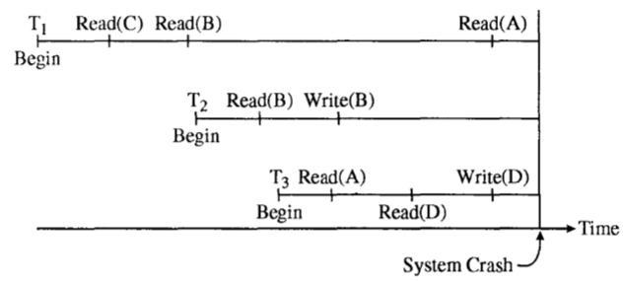
1.6.1. Failure Classification
Local Failure: it affects only the transaction in which the failure has actually occurred.
Global Failure: it affects all of the transaction in progress at the time of the failure.
Global Failure fall into two broad categories are System Failure and Media Failure.

Slide 52
1.6.1. Failure Classification
System Failure: There are various types of failure that may occur in a system.
Transaction Failure: There are two types of errors that may occur.
a. Logical Error: wrong input, data not found, resources limit exceeded.
b. System Error: The deadlock occurred in system, starvation in system.
ii. System Crash: There is a hardware malfunction, or a bug in the DBMS or the OS
2. Media Failure: A media failure is sometimes called a hard crash.
Disk Failure is an example of Media Failure.

Slide 53
1.6.2. Types of Transaction Recovery
Transaction log plays an important role for database recovery and brings the database in a consistent state in the event of failure.
Transaction represent the basic unit of recovery in a database system.
The recovery manager guarantees the atomicity and durability properties of transactions in the event of failure.
During recovery from failure, the recovery manager ensures that either all the effects of a given transaction are permanently recorded in the database or none of them are recorded.

Slide 54
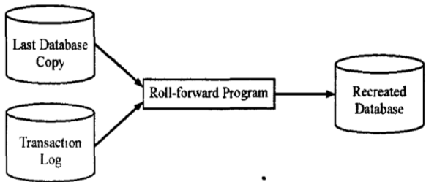
1. Forward Recovery (REDO) Also called roll-forward
Forward recovery is the recovery procedure, which is used in case of a physical damage. E.g. crash of disk pack (secondary storage),
Failures during writing of data to database buffers or
Failure during transferring buffers to secondary storage.
The forward recovery guarantees the durability property of transaction.
Forward (roll-forward) recovery or redo

Slide 55
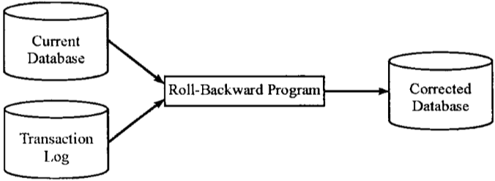
2. Backward Recovery (UNDO) Also called roll-backward
It is the recovery procedure, which is used in case an error occurs in the midst of normal operation on the database.
If the transaction had not committed at the time of failure then recovery manager must undo (roll back) any effects of the transaction database.
The backward recovery guarantees the atomicity property of transactions.

Slide 56
1.6.2.3. Recovery with Concurrent Transactions
When more than one transactions are being executed in parallel, the logs are interleaved.
To ease this situation most modern DBMS, use the concept of checkpoints.
Checkpoint is a mechanism where all the previous logs are removed from the system and stored permanently in storage disk.
Checkpoint declares a point before which the DBMS was in consistent state and all the transactions were committed.

Slide 57
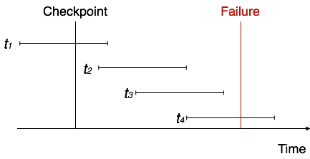
1.6.2.3. Recovery with Concurrent Transactions
Recovery with concurrent transactions
The recovery system reads the logs backwards from the end to the last Checkpoint.
It maintains two lists, undo-list and redo-list:
If the recovery system sees a log with <Tn, Start> and <Tn, Commit> it puts the transaction in redo-list.
If the recovery system sees a log with <Tn, Start> but no commit or abort log found, it puts the transaction in undo-list.
All transactions in undo-list are then undone and their logs are removed.
All transaction in redo-list, their previous logs are removed and then redone again and log saved.

Slide 58
1.7. Database Recovery
It is the process of restoring the database to a correct state in the event of a failure.
Four types of media:
System crashes due to hardware or software errors, resulting in loss of main memory;
Media failures resulting in the loss of parts of secondary storage;
Application software errors, such as logical errors in the program
Natural physical disasters, such as ﬁres, ﬂoods, earthquakes, or power failures;
Damage, or intentional corruption or destruction of data, hardware, or software facilities.

Slide 59
Whatever the cause of the failure, there are two principal effects that we need to consider:
1. The loss of main memory, including the database buffers,
2. The loss of the disk copy of the database.
1.7.1. Recovery Facilities
DBMS should provide following facilities to assist with recovery.
1. Backup mechanism, which makes periodic backup copies of database
2. Logging facilities, which keep track of current state of transactions and database changes
3. Checkpoint facility, which enables updates to database in progress to be made permanent
4. Recovery manager, which allows DBMS to restore the database to a consistent state following a failure.

Slide 60
1.7.1.1. Backup Mechanism
Backup is the copying of physical or virtual files or databases to a secondary location for preservation in case of equipment failure or disaster.
General categories: full backups and incremental backups
Depend on database open or closed consistent backup and inconsistent backup.
Two methods: user-managed backup and recovery tool called Recovery Manager.
Typically, a backup copy is produced at least once per day.
The copy should be stored in a secured location.
The backup copy is used to restore the database in the event of failure.
With large databases, regular backups may be impractical.
Backups may be taken of dynamic data regularly but backups of static data, which do not change frequently, may be taken less often.

Slide 61
1.7.1.2. Logging Facilities
There are two types of log, transaction log and database change log.
Transaction log: contains a record of the essential data for each transaction.
Data that are typically recorded for each transaction log include:
The transaction code, action or type of transaction, transaction time, user ID, input data values, table and records accessed, records modiﬁed, and old and new ﬁeld values.
Database change log: log contains before and after images of records that have been modiﬁed by transactions.
Before-image is a copy of a record before it has been modiﬁed.
After-image is a copy of the same record after it has been modiﬁed.

Slide 62
1.7.1.3. Checkpoint Facility
A checkpoint facility in a DBMS periodically refuses to accept any new transactions.
1.7.1.4. Recovery Manager (RMAN)
RMAN is a module of the DBMS which restores the database to a correct condition when a failure occurs and which resumes processing user requests.
The recovery manager uses the logs to restore the database.

Slide 63
1.7.1.4. Recovery Techniques
1. Deferred update: not written to the database until after a transaction commit.
It’s necessary to redo updates of committed transactions as their eﬀect may not have reached database.
2. Immediate update: It is applied to database as they occur.
There is a need to redo updates of committed transactions following a failure.
If no “transaction commit” record in log, then that transaction was active at failure and must be undone.
3. Shadow paging: It maintains two page tables during life of a transaction, current page and shadow page table.
When transaction starts, two pages are the same.
Shadow page table is never changed there after and is used to restore database in the event of failure.

Slide 64
1.7.4. Crash Recovery
It is the process of protecting the database from catastrophic system and media failures.
Saving checkpoints: It will save the status of the database in the period of time duration.
Steal approach: In this case, the object can be written into disk before the transaction which holds the object is committed.
Forcing pages: once if the transaction completed the entire objects associated with it should be forced to disk or written to the disk.

Slide 65
THANK YOU

